Slide 1
Puzzled By Puzzle Caches?

Slide 2
What is a Puzzle Cache?
Any geocache where the CO has placed nothing at the posted coordinates is a “mystery” or “puzzle” cache.

Slide 3
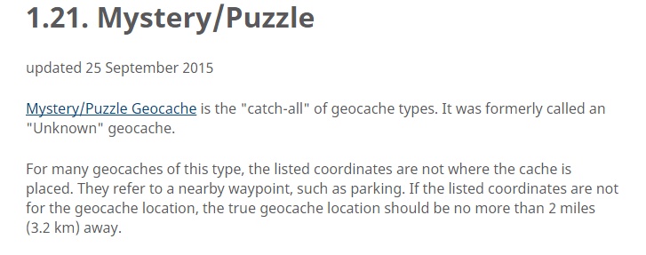
What is a Puzzle Cache?
Any geocache where the CO has placed nothing at the posted coordinates is a “mystery” or “puzzle” cache.

Slide 4
What is a Puzzle Cache?
Mystery Cache – a general catch-all name for ? Caches.

Slide 5
What is a Puzzle Cache?
Mystery Cache – a general catch-all name for ? Caches.
Challenge Cache – a variation of Mystery Cache in which the cacher must meet some reasonable geocaching-related qualification.

Slide 6
What is a Puzzle Cache?
Mystery Cache – a general catch-all name for ? Caches.
Challenge Cache – a variation of Mystery Cache in which the cacher must meet some reasonable geocaching-related qualification.
Beacon Cache – utilizes a wireless beacon that transmits a brief message that is used to find the cache.

Slide 7
What is a Puzzle Cache?
Mystery Cache – a general catch-all name for ? Caches.
Challenge Cache – a variation of Mystery Cache in which the cacher must meet some reasonable geocaching-related qualification.
Beacon Cache – utilizes a wireless beacon that transmits a brief message that is used to find the cache.
Bonus Cache – found by gathering clues from other caches.

Slide 8
What is a Puzzle Cache?
Mystery Cache – a general catch-all name for ? Caches.
Challenge Cache – a variation of Mystery Cache in which the cacher must meet some reasonable geocaching-related qualification.
Beacon Cache – utilizes a wireless beacon that transmits a brief message that is used to find the cache.
Bonus Cache – found by gathering clues from other caches.
Night Cache – designed to be found at night, often by placing reflectors or hints readable by UV light.

Slide 9
What is a Puzzle Cache?
Mystery Cache – a general catch-all name for ? Caches.
Challenge Cache – a variation of Mystery Cache in which the cacher must meet some reasonable geocaching-related qualification.
Beacon Cache – utilizes a wireless beacon that transmits a brief message that is used to find the cache.
Bonus Cache – found by gathering clues from other caches.
Night Cache – designed to be found at night, usually by placing reflectors or placing hints readable by UV light.
Tunnel Crawl – the posted cords are at the entrance…

Slide 10
What is a Puzzle Cache?
Mystery Cache – a general catch-all name for ? Caches.
Challenge Cache – a variation of Mystery Cache in which the cacher must meet some reasonable geocaching-related qualification.
Beacon Cache – utilizes a wireless beacon that transmits a brief message that is used to find the cache.
Bonus Cache – found by gathering clues from other caches.
Night Cache – designed to be found at night, usually by placing reflectors or placing hints readable by UV light.
Tunnel Crawl – the posted cords are at the entrance…
Puzzle Cache – the cacher must solve a puzzle to obtain the coordinates of the cache.

Slide 11
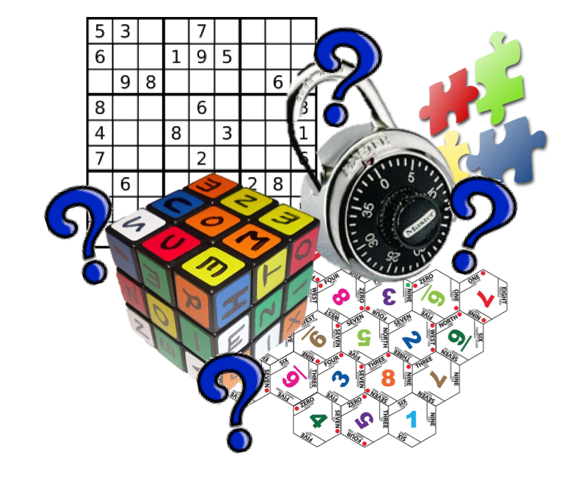
Puzzle Caches
How do you solve Puzzle Caches?

Slide 12
Puzzle Caches
Locate all components of the puzzle

Slide 13
Puzzle Caches
Locate all components of the puzzle
Solve the puzzle

Slide 14
Puzzle Caches
Locate all components of the puzzle
Solve the puzzle
Find the cache!

Slide 15
Puzzle Caches
Locate all components of the puzzle
Solve the puzzle
Find the cache!
This presentation is mainly about Step One:
locate all components of the puzzle

Slide 16
Puzzle Caches
Locate all components of the puzzle
Solve the puzzle
Find the cache!
Attend the Spring Event Puzzles 101 for Step Two!

Slide 17
The Puzzle Cache Clue Checklist
In Plain Sight
Page content
Text
Images
Title
A cache by…
Related Web Page
Attributes
Difficulty
Hidden Clues
On The Page
“invisible” text
hyperlinks
In The Images
In the Source Code

Slide 18
“In Plain Sight” Puzzles
Sometimes all you need is right there on the page…
Presidential Style
Recommended Reading
Star Trek Sudoku: NCC-1705
Who can solve my puzzle?
dot number dot geocache
For these it’s just a matter of figuring out how to solve the puzzle.

Slide 19
“In Plain Sight” Puzzles
Look at the title…
JRRT
Beyond Third Base
Sue M. Moralés
Jenny

Slide 20
“In Plain Sight” Puzzles
Look at the title…
JRRT
Beyond Third Base
Sue M. Moralés
Jenny
Googling the title is occasionally productive…
Library of Babel

Slide 21
“In Plain Sight” Puzzles
Occasionally “A cache by…” will provide a clue…
25 or 6 to 4, by Chicago
Angles and Sides
4 by 10 in 5's

Slide 22
“In Plain Sight” Puzzles
Sometimes both title and “A cache by…”!
boLshoi boozE

Slide 23
“In Plain Sight” Puzzles
If there is a “Related Web Page” check it out!
L•U•N•A•R
EASY Mystery, Spend it Wisely P.I.F.

Slide 24
“In Plain Sight” Puzzles
Also check the Image Gallery.
Some are obvious…
Son of Cowboy Kakuro

Slide 25
“In Plain Sight” Puzzles
Also check the Image Gallery.
Some are obvious…
Son of Cowboy Kakuro
Others, not so much…
EZ Smiley #57

Slide 26
“In Plain Sight” Puzzles
Are there background images on the cache page?
Oklahoma's Rt. 66 Puzzle Cache
Age of Empires

Slide 27
“In Plain Sight” Puzzles
Copy the image to the desktop, then drag into Google Image Search.

Slide 28
“In Plain Sight” Puzzles
Copy the image to the desktop, then drag into Google Image Search.
The background image might be in the Image Gallery.

Slide 29
“In Plain Sight” Puzzles
Copy the image to the desktop, then drag into Google Image Search.
The background image might be in the Image Gallery.
Otherwise you might have to look for it in the source code.

Slide 30
“In Plain Sight” Puzzles
Check The Source Code

Slide 31
“In Plain Sight” Puzzles
Check The Source Code
“View Page Source”

Slide 32
“In Plain Sight” Puzzles
Check The Source Code
“View Page Source”
(often this is an option when you right-click on the page)

Slide 33
“In Plain Sight” Puzzles
Check The Source Code
“View Page Source”
(often this is an option when you right-click on the page)
Search for Background

Slide 34
“In Plain Sight” Puzzles
Check The Source Code
“View Page Source”
(often this is an option when you right-click on the page)
Search for Background
Find the link for the background image

Slide 35
“In Plain Sight” Puzzles
Check The Source Code
“View Page Source”
(often this is an option when you right-click on the page)
Search for Background
Find the link for the background image
Open the image in a new tab

Slide 36
“In Plain Sight” Puzzles
Check The Source Code
“View Page Source”
(often this is an option when you right-click on the page)
Search for Background
Find the link for the background image
Open the image in a new tab
Now you can search for that image, print it, or whatever…

Slide 37
“In Plain Sight” Puzzles
Be wary of distractors…
03-K64-Firefly

Slide 38
“In Plain Sight” Puzzles
What is the Difficulty rating?
Hodor

Slide 39
QUIZ
Where is the puzzle?
1-800-666-EZRT

Slide 40
“Hidden Clues” Puzzles
Highlight the page!
The Bezirkle Phenomenon
Dewey Cemetery

Slide 41
“Hidden Clues” Puzzles
Highlight the page!
The Bezirkle Phenomenon
Dewey Cemetery
The hidden clue can be subtle…
Help Fleur Morgan

Slide 42
“Hidden Clues” Puzzles
Multiple Techniques Required:
Find the linked clue, and highlight the page.
All Hail Caesar

Slide 43
“Hidden Clues” Puzzles
Text Incorporated Into Images
Mental Anguish
The Guardian
Search for the image and compare to what you found online.
Copy the image into a graphics program and examine every detail!

Slide 44
“Hidden Clues” Puzzles
Text Incorporated Into Images
Witness Protection
Sometimes the information in the image is hidden.
Examine the image carefully using a graphics program.
Adjust the brightness and contrast to search for hidden text.

Slide 45
“Hidden Clues” Puzzles
Text Incorporated Into Images
Witness Protection
RECOMMENDED: GIMP for Windows (Free)

Slide 46
“Hidden Clues” Puzzles
Text Imbedded In Image Code
Gators Don't Like Snakes
Copy the image to the desktop, then drag it into Notepad.

Slide 47
“Hidden Clues” Puzzles
Check The Source Code
“View Page Source”

Slide 48
“Hidden Clues” Puzzles
Check The Source Code
“View Page Source”
(often this is an option when you right-click on the page)

Slide 49
“Hidden Clues” Puzzles
Check The Source Code
“View Page Source”
(often this is an option when you right-click on the page)
Search for UserSuppliedContent

Slide 50
“Hidden Clues” Puzzles
Check The Source Code
“View Page Source”
(often this is an option when you right-click on the page)
Search for UserSuppliedContent
There are usually two such blocks, often adjacent.

Slide 51
“Hidden Clues” Puzzles
Check The Source Code
“View Page Source”
(often this is an option when you right-click on the page)
Search for UserSuppliedContent
There are usually two such blocks, often adjacent.
Examine Everything!

Slide 52
“Hidden Clues” Puzzles
Check The Source Code
When you check the source code, you’re looking at two regions:

Slide 53
“Hidden Clues” Puzzles
Check The Source Code
When you check the source code, you’re looking at two regions:
Background

Slide 54
“Hidden Clues” Puzzles
Check The Source Code
When you check the source code, you’re looking at two regions:
Background
Check this even if you don’t see a background image on the page.

Slide 55
“Hidden Clues” Puzzles
Check The Source Code
When you check the source code, you’re looking at two regions:
Background
Check this even if you don’t see a background image on the page.
UserSuppliedContent

Slide 56
“Hidden Clues” Puzzles
Check The Source Code
When you check the source code, you’re looking at two regions:
Background
Check this even if you don’t see a background image on the page.
UserSuppliedContent
Check everything in this region!

Slide 57
“Hidden Clues” Puzzles
Some crafty COs will hide information in the background images,
or will even have a “white” background image
with information imbedded within it.

Slide 58
“Hidden Clues” Puzzles
Sometimes it’s pretty obvious…
Joyride
Beware of distractors! Always check the source code!
EZ Smiley #51

Slide 59
“Hidden Clues” Puzzles
Clues In The Source Code
Ultron
Hungry for a puzzle cache?
Sunny Duck-Duck Hunt (and others)

Slide 60
“Hidden Clues” Puzzles
Crafty COs will make clues a part of the actual HTML!
Grey Matter

Slide 61
“Hidden Clues” Puzzles
Some puzzles have hyperlinks that are difficult to locate from the page; check the source code to locate these.
The Gray Code
UCO History

Slide 62
“Hidden Clues” Puzzles
Watch for linked files that have different names than the original!
Tunnel Vision

Slide 63
“Hidden Clues” Puzzles
This is your final exam.
Can you eliminate the distractors and find the puzzle?
What Lies Beneath

Slide 64
References
How To Puzzle Cache by Cully Long

